Slide 1
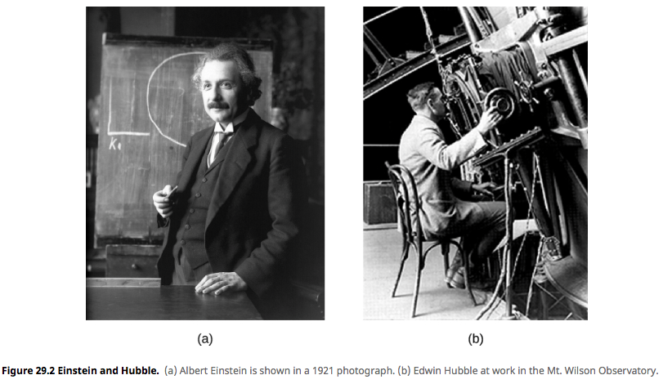
The beginning of modern cosmology
Einstein was right (solving for the infinite universe),
then wrong (unwilling to accept the expanding universe),
then right again (cosmological constant to explain accelerating universe).
Notes:
Einstein was right (solving for the infinite universe), then wrong (unwilling to accept the expanding universe), then right again (cosmological constant to explain accelerating universe).

Slide 2
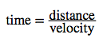
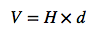
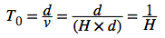
In class activity: calculating Hubble Time (a.k.a, the age of the Universe)
H = 70 km/s/Mpc
The Hubble Law:
1 Mpc = 3 x 10¹⁹ km
Age of Universe:
Question: find your Hubble constant and calculate the
age of the Universe. Compared to 13.8 Gry, is it too big, small,
or just right?
What could be the problem?

Slide 3
What if Hubble Constant is changing?
Faster moving away
Decelerating Universe (<13.5 Gyr)
Hubble
Constant
Constant Universe
Accelerating Universe (>13.5 Gyr)
Slower moving away
Early time
Current time

Slide 4
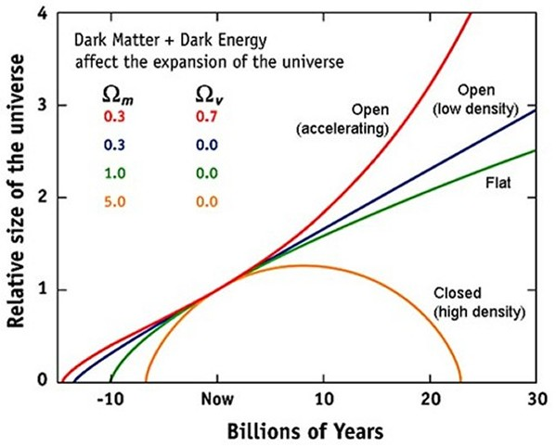
Accelerating
Accelerating
Constant
Decelerating

Slide 5
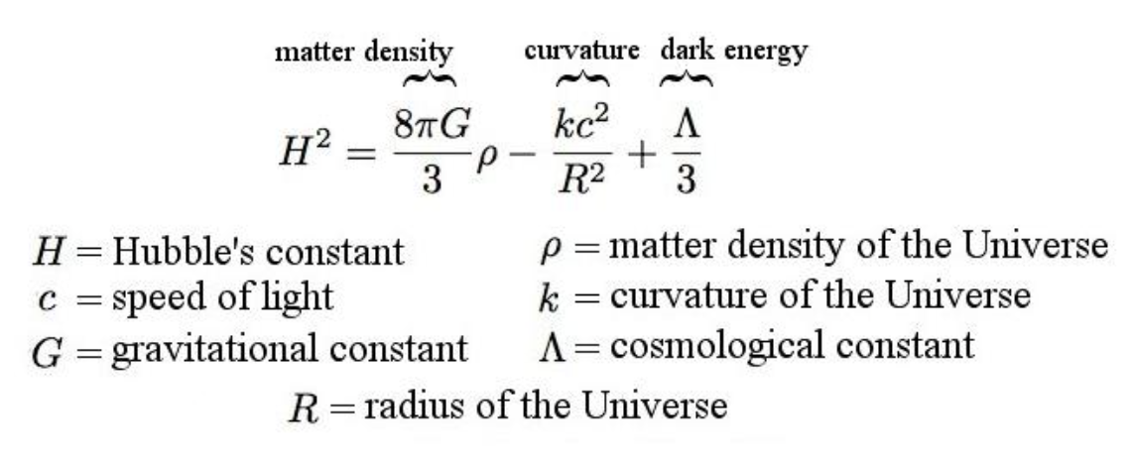
Modern Cosmology

Slide 6
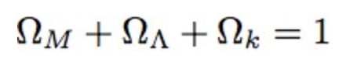
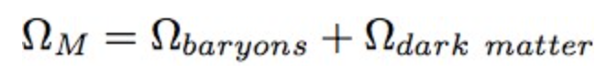
A simplified version
Mass density
Dark energy
Curvature

Slide 7
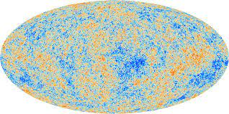
Curvature of the Universe is measured by the Cosmic Microwave Background (CMB)

Slide 8
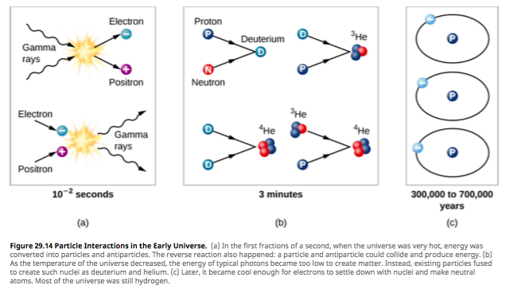
CMB originates from Recombination of electrons
Notes:
(1), neutrino escape at 1 second, (2) nuclear fusion between 3 and 4 min, explain Helium excess, (3) deuterium is a fossil and can be used to present day matter density

Slide 9
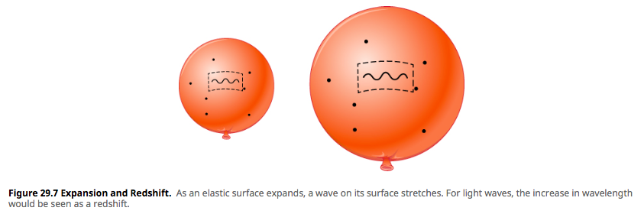

A new way of thinking about an expanding universe
Temperature at recombination ~3000 K
Corresponding wavelength is
~ 1 um

Slide 10
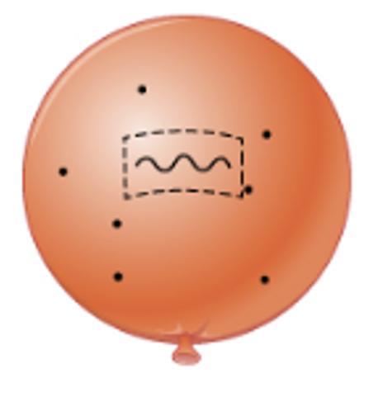
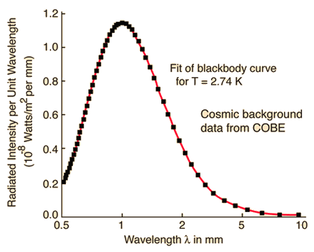
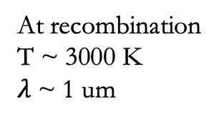
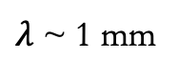
Calculating the redshift at the epoch of recombination
Now that the universe
has expanded and cooled
At recombination
T ~ 3000 K
$λ$~ 1 um
$λ$~ 1 mm
What is the redshift at the
epoch of recombination?
z=1 mm/ 1 um = 1000

Slide 11
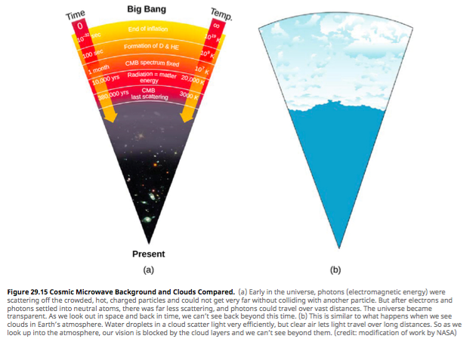
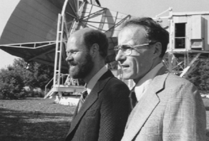
Cosmic Microwave Background
https://www.youtube.com/watch?v=3tCMd1ytvWg

Slide 12

Why does CMB have anything to do with the curvature of the Universe?

Slide 13
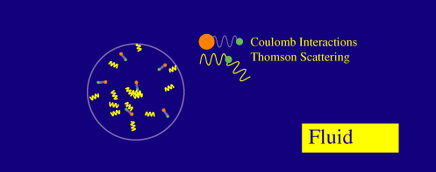
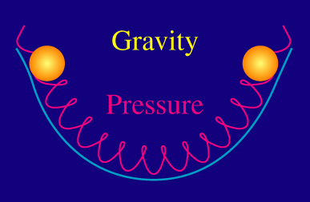
Why does CMB have anything to do with the curvature of the Universe?

Slide 14
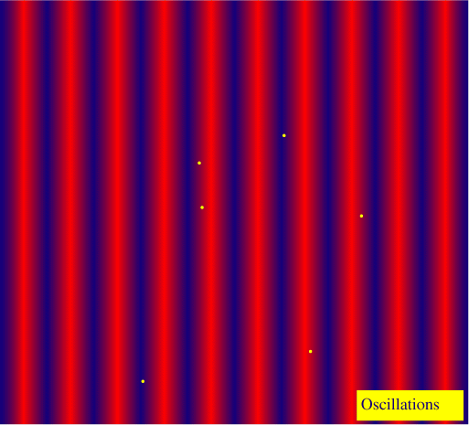
When the universe expands and cools, the supporting pressure disappears due the recombination of the electrons

Slide 15
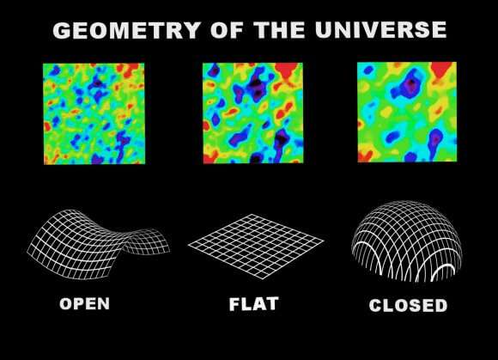

Slide 16
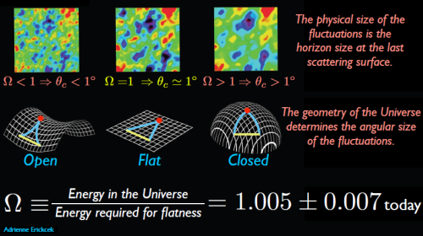

Slide 17
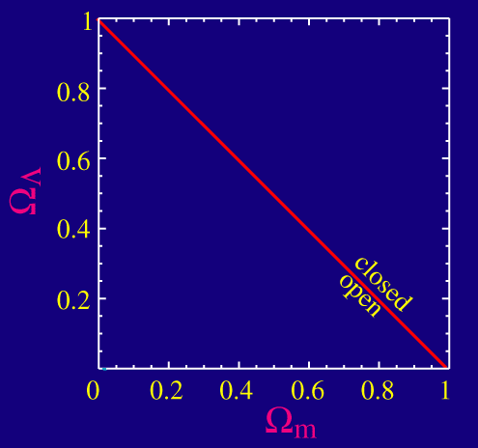

Slide 18
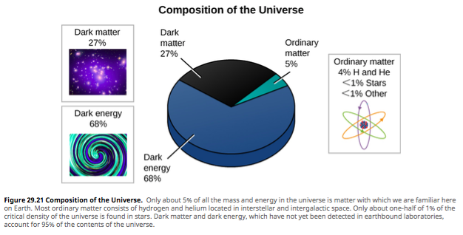
What is the universe made of?

Slide 19
A type Ia supernova is a type of supernova that occurs in binary systems (two stars orbiting one another) in which one of the stars is a white dwarf.

Slide 20
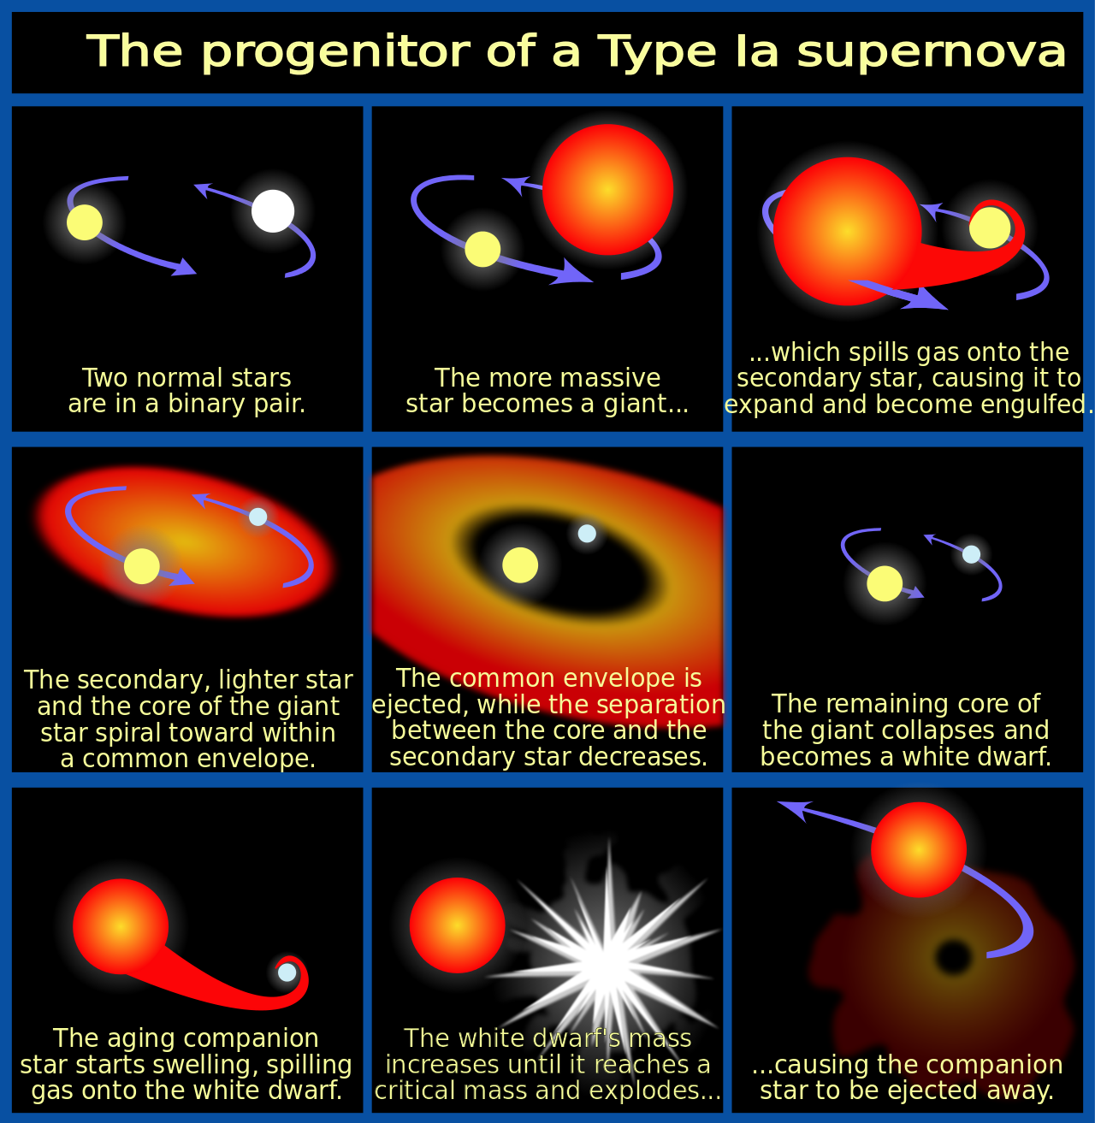

Slide 21
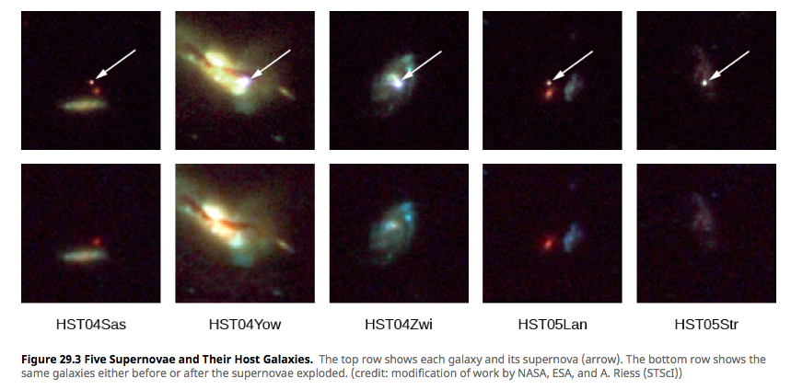
The Universe is accelerating!
Supernovae at high redshift appear to be fainter than expected from Hubble law

Slide 22
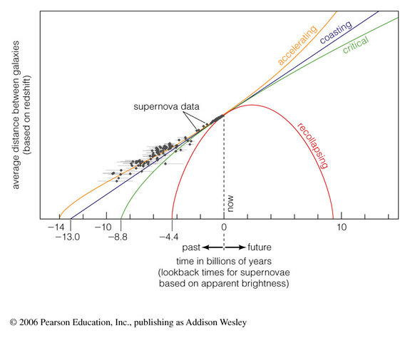

Slide 23
Accelerating
Accelerating
Constant
Decelerating

Slide 25
Group discussion
What will happen if the universe continues expanding and stretching?
distance between stars and galaxies?
What happens to stars as they all evolve?
What are the last stars remaining shining
Then what happens?
Notes:
What will happen if the universe continues expanding and stretching (distance between stars and galaxies, stars->WD, NS->black out, BD the last become, then all black out! (Class activity)

Slide 26
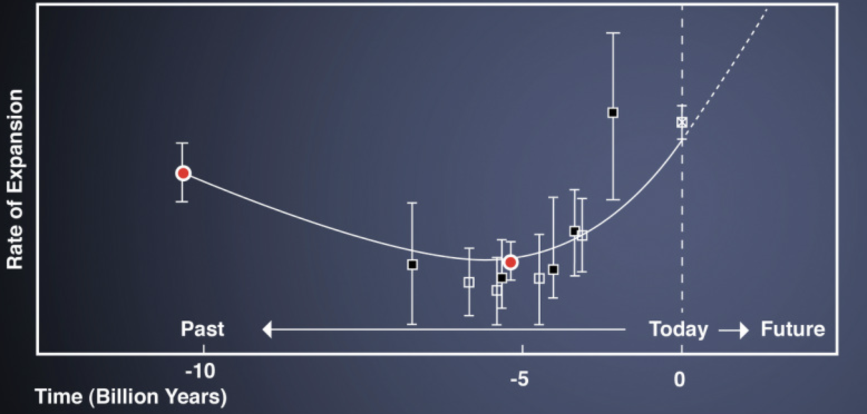
The expansion history of the universe
Radiation dominated
Dark energy dominated
Matter dominated
Notes:
http://abyss.uoregon.edu/~js/ast123/lectures/lec16.html

Slide 27
